Slide 1
10
C Structures, Unions and Enumerations

Slide 2
10.1 Introduction
10.2 Structure Definitions
10.3 Initializing Structures
10.4 Accessing Members of Structures
10.5 Using Structures with Functions
10.6 typedef
10.7 Example: High-Performance Card Shuffling and Dealing Simulation
10.8 Unions
10.11 Enumeration Constants

Slide 3
10.1 Introduction
Structures
  Collections of related variables (aggregates) under one name
    Can contain variables of different data types
  Commonly used to define records to be stored in files
  Combined with pointers, can create linked lists, stacks, queues, and trees

Slide 4
10.2 Structure Definitions
Example
      struct card {
      char *face;
      char *suit;
      };
  struct introduces the definition for structure card
  card is the structure name and is used to declare variables of the structure type
  card contains two members of type char *
    These members are face and suit

Slide 5
Common Programming Error 10.1
Forgetting the semicolon that terminates
a structure definition is a syntax error.

Slide 6
10.2 Structure Definitions
struct information
  A struct cannot contain an instance of itself
  Can contain a member that is a pointer to the same structure type
  A structure definition does not reserve space in memory
    Instead creates a new data type used to define structure variables
Definitions
  Defined like other variables:
      struct card oneCard, deck[ 52 ], *cPtr;
  Can use a comma separated list:
      struct card {
      char *face;
      char *suit;
      } oneCard, deck[ 52 ], *cPtr;

Slide 7
Good Programming Practice 10.1
Always provide a structure tag name when creating a structure type. The structure tag name is convenient for declaring new variables of the structure type later in the program.

Slide 8
Good Programming Practice 10.2
Choosing a meaningful structure tag name helps make a program self-documenting.

Slide 9
10.2 Structure Definitions
Valid Operations
  Assigning a structure to a structure of the same type
  Taking the address (&) of a structure
  Accessing the members of a structure
  Using the sizeof operator to determine the size of a structure

Slide 10
Common Programming Error 10.2
Assigning a structure of one type to a structure of a different type is a compilation error.

Slide 11
Common Programming Error 10.3
Comparing structures is a syntax error.

Slide 12

Fig. 10.1 | Possible storage alignment for a variable of type struct example showing an undefined area in memory.

Slide 13
Portability Tip 10.1
Because the size of data items of a particular type is machine dependent and because storage alignment considerations are machine dependent, so too is the representation of a structure.

Slide 14
10.3 Initializing Structures
Initializer lists
  Example:
    struct card oneCard = { "Three", "Hearts" };
Assignment statements
  Example:
    struct card threeHearts = oneCard;
  Could also define and initialize threeHearts as follows:
    struct card threeHearts;
    threeHearts.face = “Three”;
    threeHearts.suit = “Hearts”;

Slide 15
10.4 Accessing Members of Structures
Accessing structure members
  Dot operator (.) used with structure variables
    struct card myCard;
    printf( "%s", myCard.suit );
  Arrow operator (->) used with pointers to structure variables
    struct card *myCardPtr = &myCard;
    printf( "%s", myCardPtr->suit );
  myCardPtr->suit is equivalent to
    ( *myCardPtr ).suit

Slide 16
Error-Prevention Tip 10.1
Avoid using the same names for members of structures of different types. This is allowed, but it may cause confusion.

Slide 17
Good Programming Practice 10.3
Do not put spaces around the -> and .
operators. Omitting spaces helps emphasize that the expressions the operators are contained in are essentially single variable names.

Slide 18
Common Programming Error 10.4
Inserting space between the - and > components of the structure pointer operator (or between the components of any other multiple keystroke operator except ?:) is a syntax error.

Slide 19
Common Programming Error 10.5
Attempting to refer to a member of a structure by using only the member’s name is a syntax error.

Slide 20
Common Programming Error 10.6
Not using parentheses when referring to
a structure member that uses a pointer and the structure member operator
(e.g., *cardPtr.suit) is a syntax error.

Slide 21
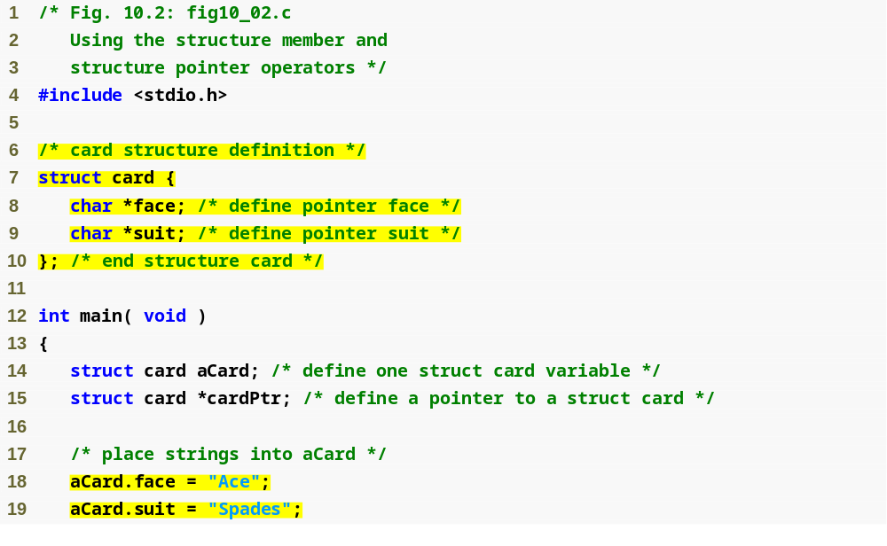
Outline
fig10_02.c
(1 of 2 )
Structure definition
Structure definition must end with semicolon
Dot operator accesses members of a structure

Slide 22
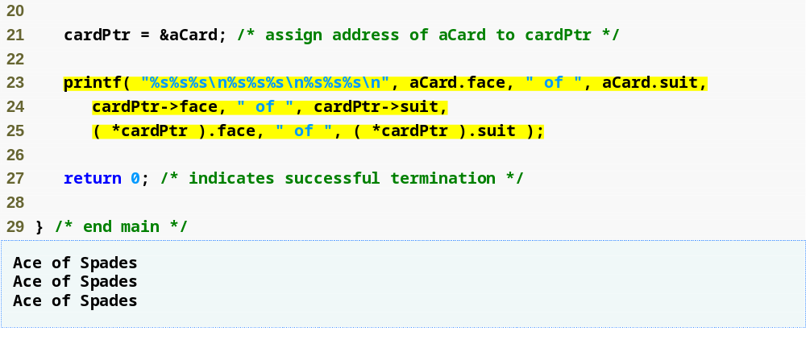
Outline
fig10_02.c
(2 of 2 )
Arrow operator accesses members of a structure pointer

Slide 23
10.5 Using Structures with Functions
Passing structures to functions
  Pass entire structure
    Or, pass individual members
  Both pass call by value
To pass structures call-by-reference
  Pass its address
  Pass reference to it
To pass arrays call-by-value
  Create a structure with the array as a member
  Pass the structure

Slide 24
Common Programming Error 10.7
Assuming that structures, like arrays, are automatically passed by reference and trying to modify the caller’s structure values in the called function is a logic error.

Slide 25
Performance Tip 10.1
Passing structures by reference is more efficient than passing structures by value (which requires the entire structure to be copied).

Slide 26
10.6 typedef
typedef
  Creates synonyms (aliases) for previously defined data types
  Use typedef to create shorter type names
  Example:
      typedef struct Card *CardPtr;
  Defines a new type name CardPtr as a synonym for type struct Card *
  typedef does not create a new data type
    Only creates an alias

Slide 27
Good Programming Practice 10.4
Capitalize the first letter of typedef names to emphasize that they are synonyms for other type names.

Slide 28
Portability Tip 10.2
Use typedef to help make a program
more portable.

Slide 29
10.7 Example: High-Performance Card Shuffling and Dealing Simulation
Pseudocode:
  Create an array of card structures
  Put cards in the deck
  Shuffle the deck
  Deal the cards

Slide 30
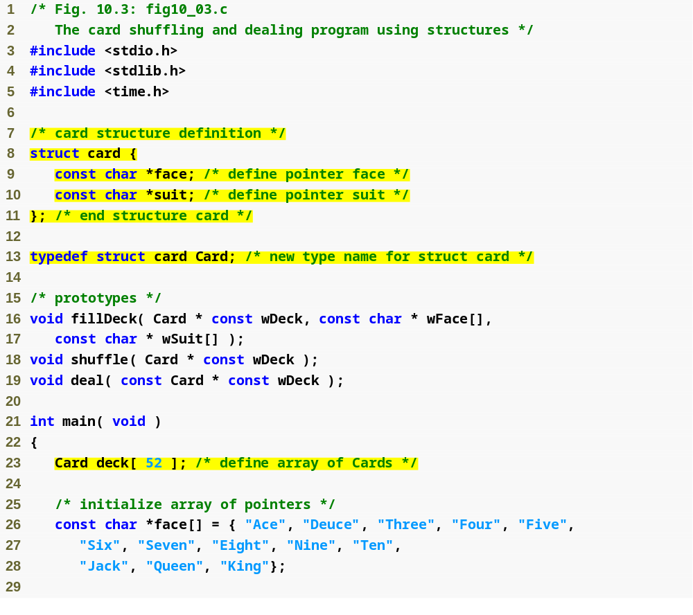
Outline
fig10_03.c
(1 of 3 )
Each card has a face and a suit
Card is now an alias for struct card

Slide 31
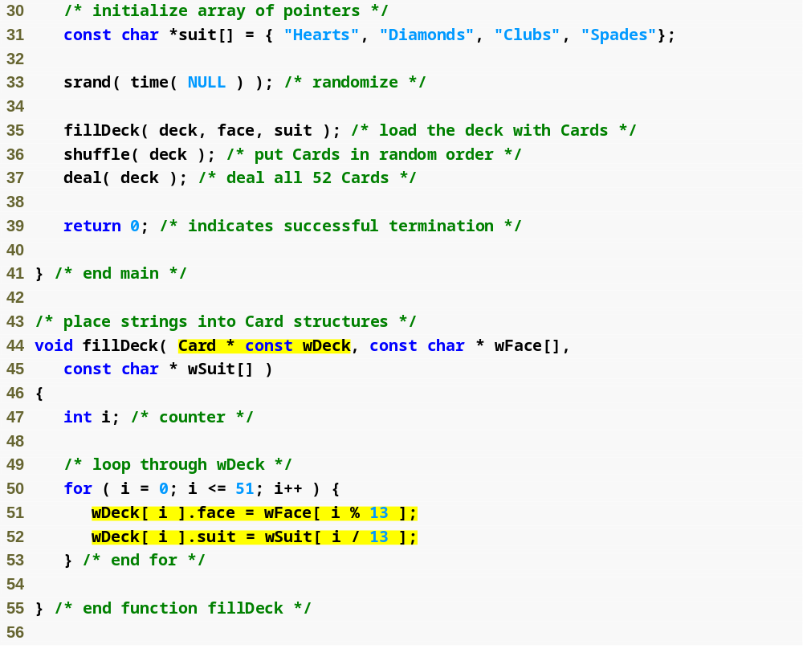
Outline
fig10_03.c
(2 of 3 )
Constant pointer to modifiable array of Cards
Fills the deck by giving each Card a face and suit

Slide 32
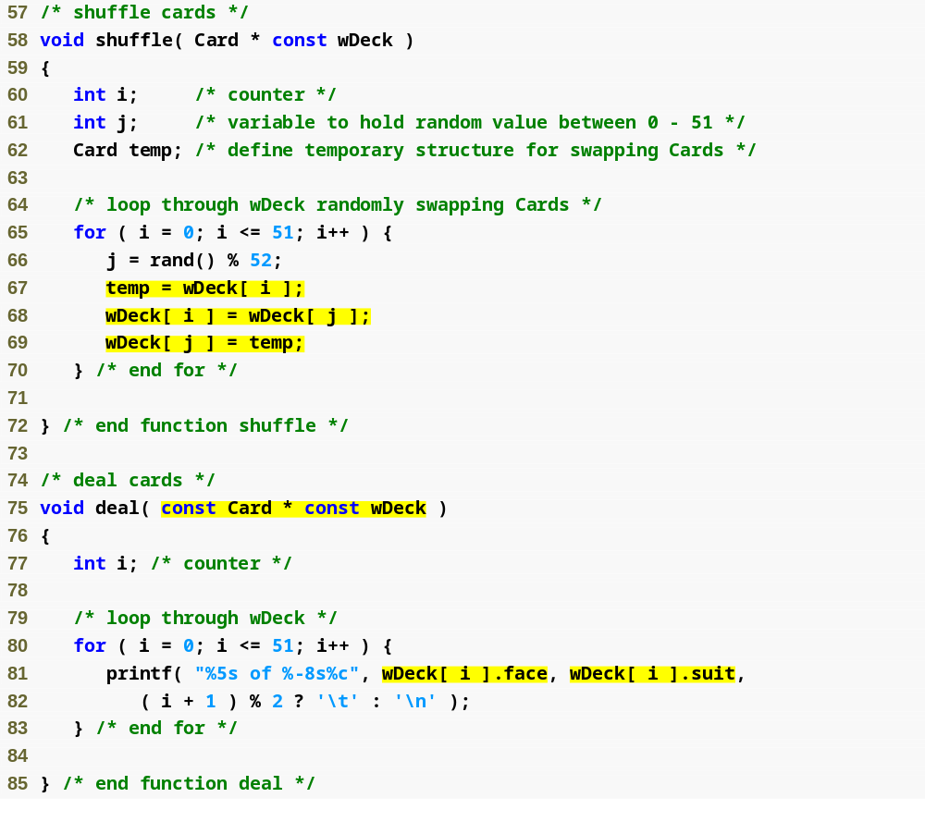
Outline
fig10_03.c
(3 of 3 )
Each card is swapped with another, random card, shuffling the deck

Slide 33
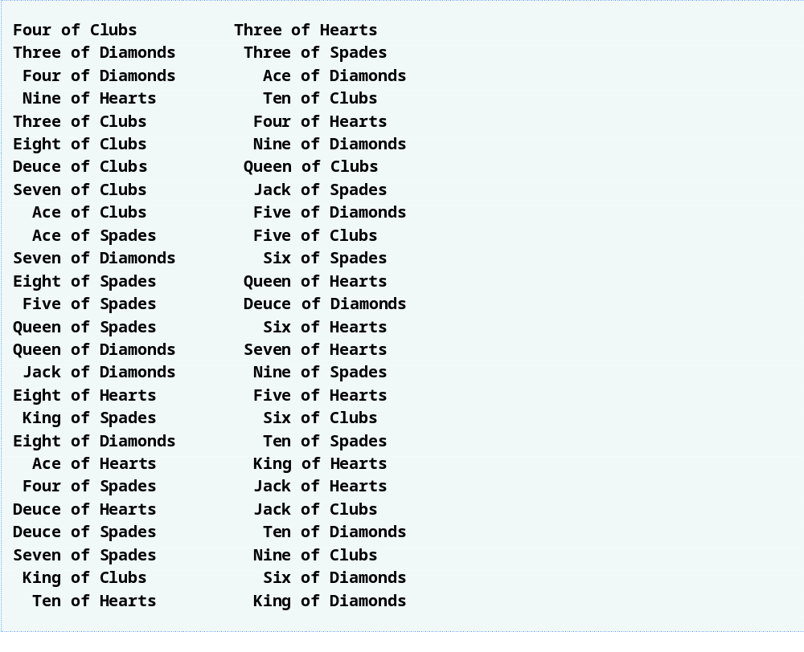
Outline

Slide 34
Common Programming Error 10.8
Forgetting to include the array subscript when referring to individual structures in an array of structures is a syntax error.

Slide 35
10.8 Unions
union
  Memory that contains a variety of objects over time
  Only contains one data member at a time
  Members of a union share space
  Conserves storage
  Only the last data member defined can be accessed
union definitions
  Same as struct
      union Number {
      int x;
      float y;
      };
      union Number value;

Slide 36
10.8 Unions
Valid union operations
  Assignment to union of same type: =
  Taking address: &
  Accessing union members: .
  Accessing members using pointers: ->

Slide 37
Common Programming Error 10.9
Referencing data in a union with a
variable of the wrong type is a logic error.

Slide 38
Portability Tip 10.3
If data is stored in a union as one type and referenced as another type, the results are implementation dependent.

Slide 39
Software Engineering Observation 10.1
As with a struct definition, a union definition simply creates a new type. Placing a union or struct definition outside any function does not create a global variable.

Slide 40
Common Programming Error 10.10
Comparing unions is a syntax error.

Slide 41
Portability Tip 10.4
The amount of storage required to store a union is implementation dependent but will always be at least as large as the largest member of the union.

Slide 42
Portability Tip 10.5
Some unions may not port easily to other computer systems. Whether a union is portable or not often depends on the storage alignment requirements for the union member data types on a given system.

Slide 43
Performance Tip 10.2
Unions conserve storage.

Slide 44
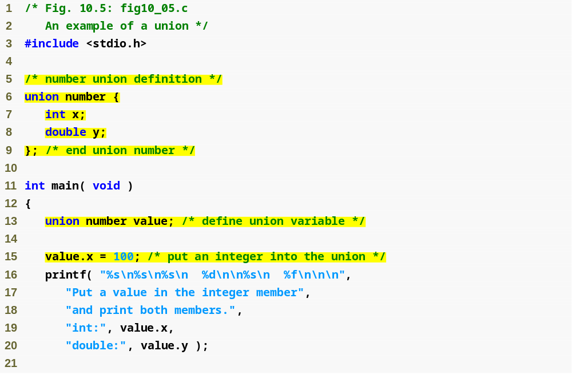
Outline
Union definition
fig10_05.c
(1 of 2 )
Union definition must end with semicolon
Note that y has no value

Slide 45
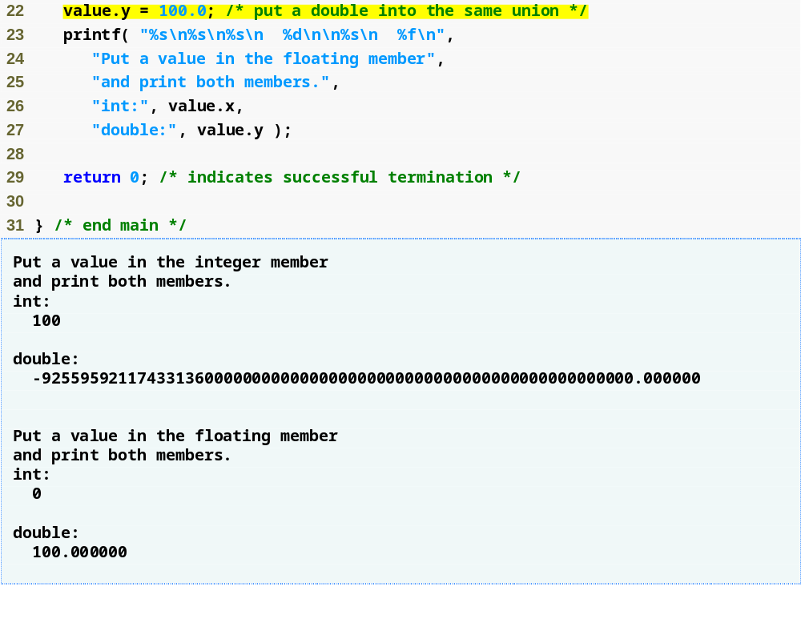
Outline
Giving y a value removes x’s value
fig10_05.c
(2 of 2 )

Slide 46
10.11 Enumeration Constants
Enumeration
  Set of integer constants represented by identifiers
  Enumeration constants are like symbolic constants whose values are automatically set
    Values start at 0 and are incremented by 1
    Values can be set explicitly with =
    Need unique constant names
  Example:
    enum Months { JAN = 1, FEB, MAR, APR, MAY, JUN, JUL, AUG, SEP, OCT, NOV, DEC};
    Creates a new type enum Months in which the identifiers are set to the integers 1 to 12
  Enumeration variables can only assume their enumeration constant values (not the integer representations)

Slide 47
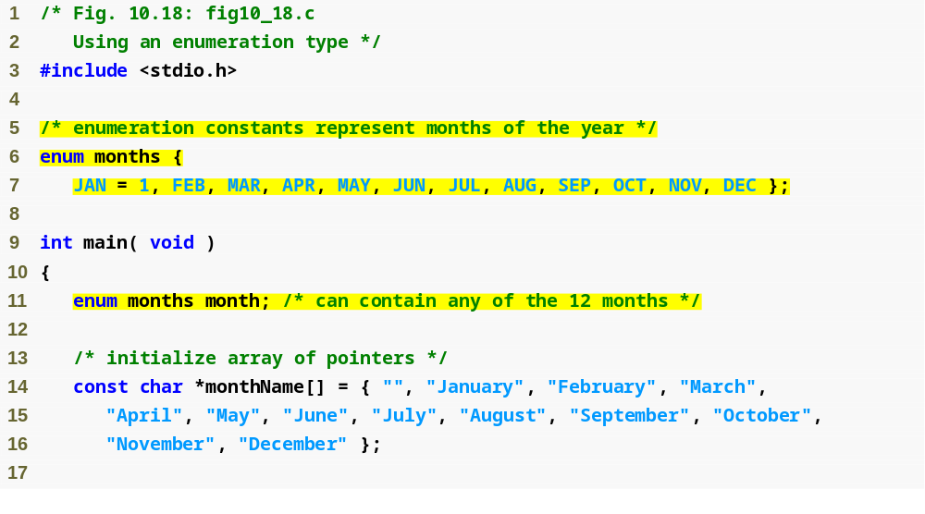
Outline
fig10_18.c
(1 of 2 )
Enumeration sets the value of constant JAN to 1 and the following constants to 2, 3, 4…

Slide 48
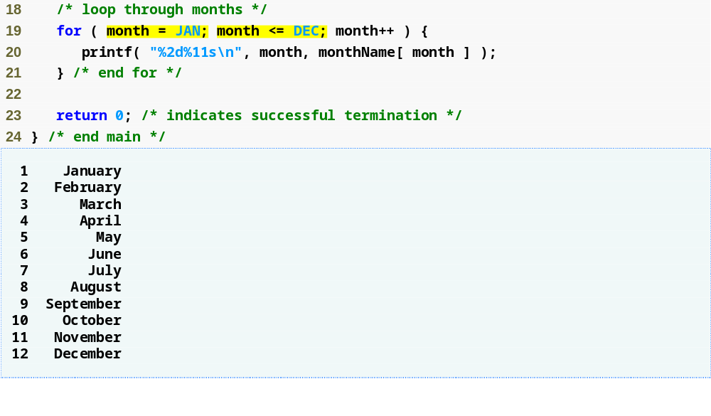
Outline
fig10_18.c
(2 of 2 )
Like symbolic constants, enumeration constants are replaced by their values at compile time

Slide 49
Common Programming Error 10.16
Assigning a value to an enumeration constant after it has been defined is a syntax error.

Slide 50
Good Programming Practice 10.5
Use only uppercase letters in the names of enumeration constants. This makes these constants stand out in a program and reminds you that enumeration constants
are not variables.

